Slide 1
Working with
Cinematic Techniques

Slide 2
Film Analysis
Much like how a writer uses stylistic devices (diction, syntax, imagery, figurative language and tone) to achieve specific effects in their writing, directors use cinematic techniques in their films for specific purposes.
In order to analyze a film through critical viewing like you do a text in critical reading, you must understand the tools that filmmakers use to create their visual masterpieces.

Slide 3
SHOTS and FRAMING, CAMERA ANGLES and CAMERA MOVEMENTS
All compare to how a writer uses POINT OF VIEW
Shot: a single piece of film uninterrupted by cuts
Of course, different shot types, angles and movements achieve different effects

Slide 4
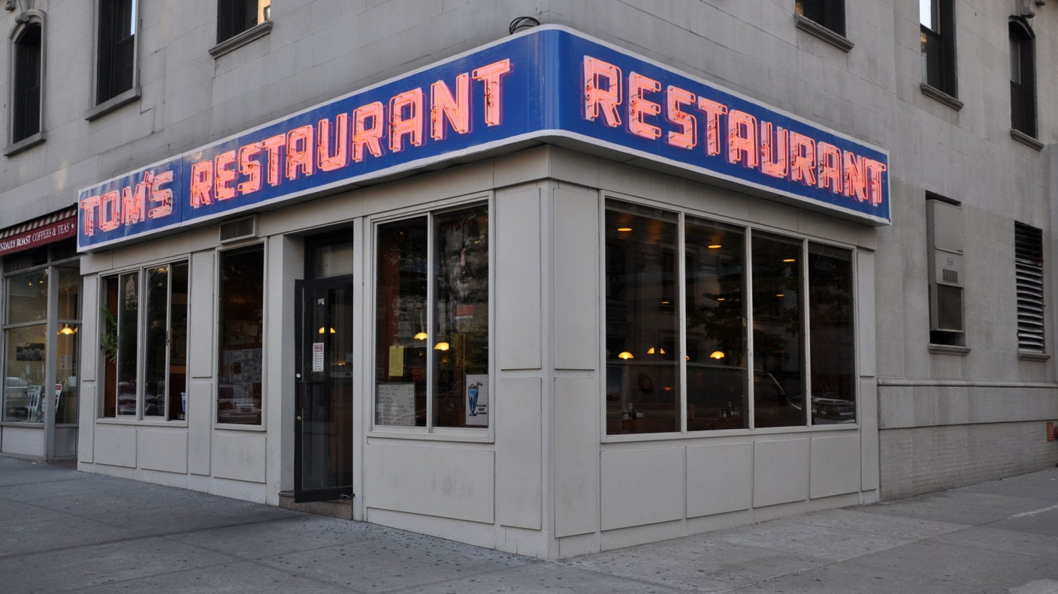
ESTABLISHING SHOT - Often a long shot or a series of shots that sets the scene; it used to establish setting and to show transitions between locations
From the TV Show Seinfeld

Slide 5
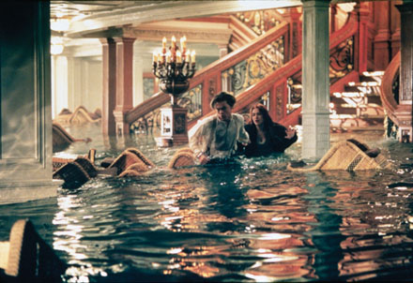
LONG SHOT – a short from some distance. If filming a person, the full body is shown. It may show the isolation or vulnerability of the character
From the movie Titanic

Slide 6
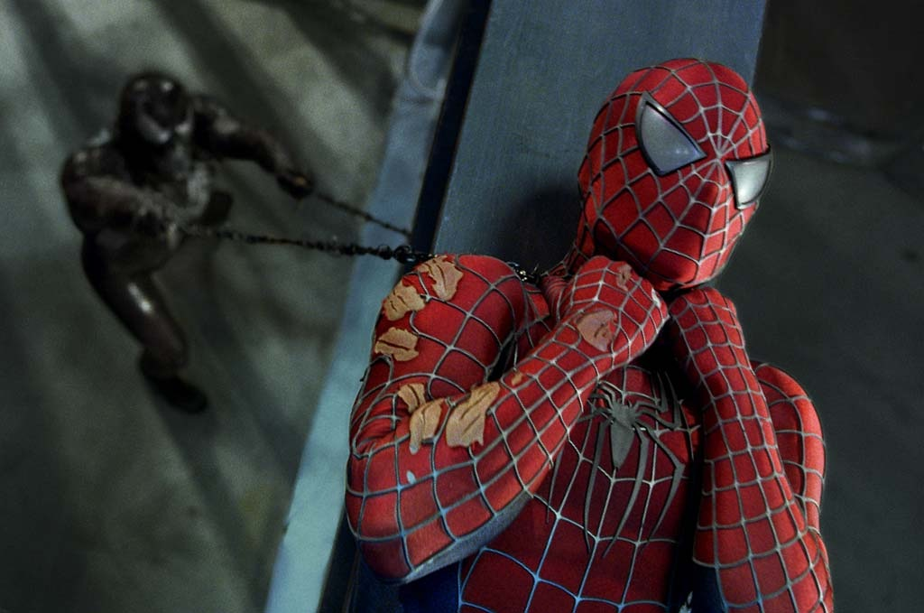
MEDIUM SHOT – the most common shot. The camera seems to be a medium distance from the object being filmed. A medium shot shows the person from the waist up. The effect is to ground the story.
From the movie Spiderman 2

Slide 7
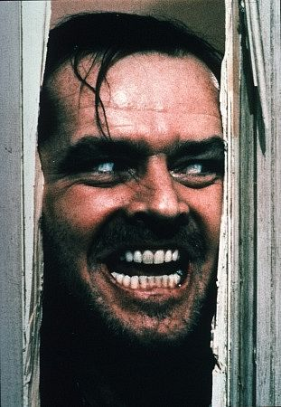
CLOSE UP – the image takes up at least 80 percent of the frame
From the movie The Shining

Slide 8
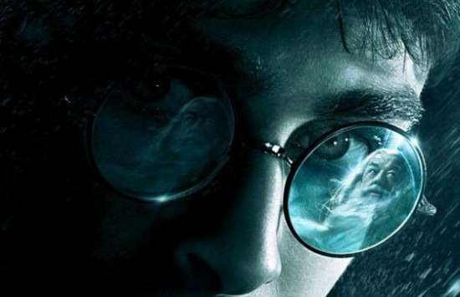
EXTREME CLOSE UP – the image being shot is a part of a whole, such as an eye or a hand
From the film Harry Potter

Slide 9
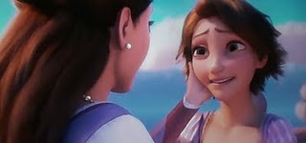
TWO SHOT – a scene between two people shot exclusively from an angle that includes both characters more or less equally. It is used in love scenes where the interaction between two characters is important.
From the movie Tangled

Slide 10
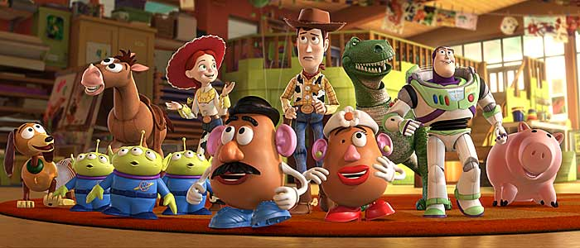
EYE LEVEL – a shot taken from normal height; that is, the character’s eye level. Ninety to ninety-five percent of the shots seen are eye level, because it is the most natural angle.
From the movie Toy Story

Slide 11
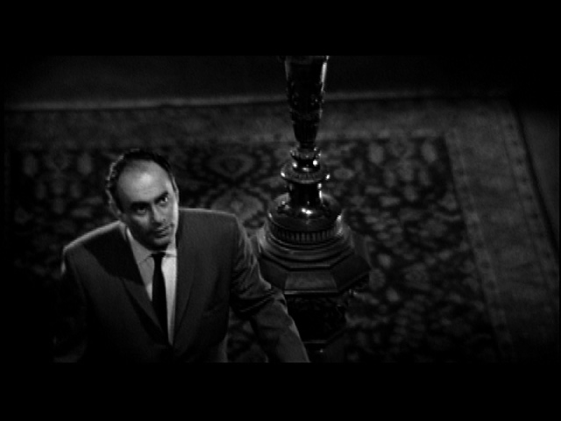
HIGH ANGLE – the camera is above the subject. This usually has the effect of making the subject look smaller than normal, giving him or her the appearance of being weak, powerless or trapped.
From the movie Psycho

Slide 12
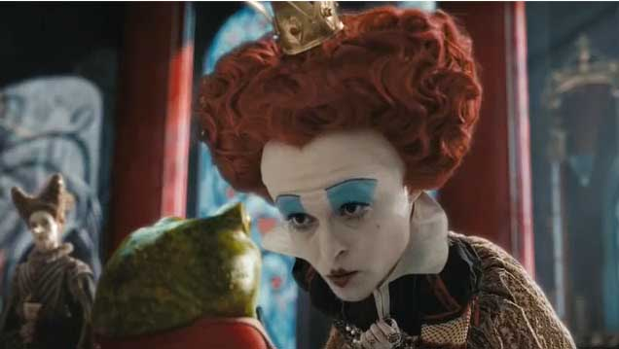
LOW ANGLE – the camera films subject from below. This usually has the effect of making the subject look larger than normal, and therefore strong, powerful, and threatening.
From the movie Alice in Wonderland

Slide 13
CAMERA MOVEMENTS
Pan – a stationary camera moves from side to side on a horizontal axis
Tilt – a stationary camera moves up or down along a vertical axis
Zoom – a stationary camera where the lens moves to make an object seems to move closer or further away from the camera. *With this technique, moving into a character is often a personal or revealing movement, while moving away distances or separates the audience from the character.
Dolly/Tracking – the camera is on a track that allows it to move with the action. The term also refers to any camera mounted on a car, truck, or helicopter.
Boom/Crane – the camera is on a crane over the action. This is used to create overhead shots.

Slide 14
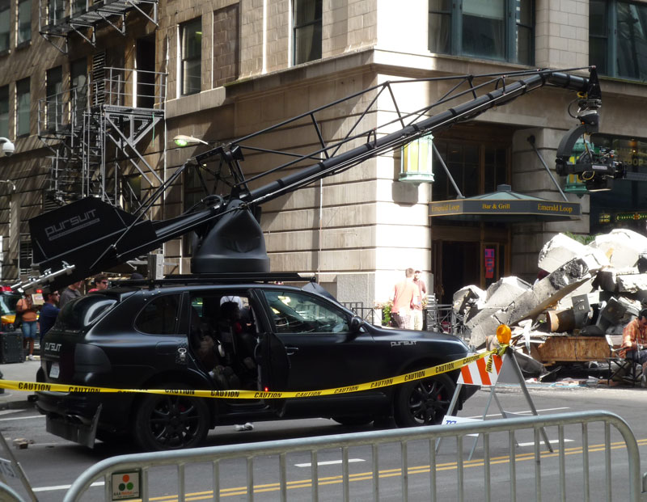
CAMERA MOVEMENTS
Use of Dolly/Tracking and Boom/Crane to shoot Transformers

Slide 15
LIGHTING
Compares to how a writer establishes tone and mood in their work
Lighting creates significant emotional responses from the audience based on what people associate with light and darkness
Lighting effects clarity, realism and emotion

Slide 16
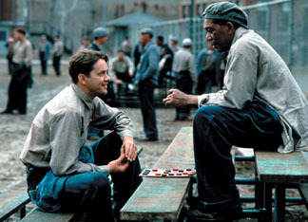
HIGH KEY – the scene is flooded with light; creating a bright and open-looking scene
From the movie Shawshank Redemption

Slide 17
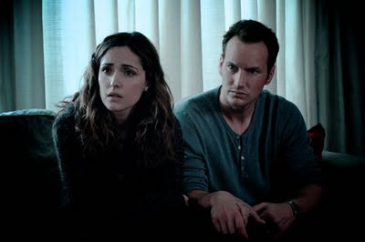
LOW KEY – the scene is flooded with shadows and darkness, creating suspense and suspicion
From the movie Insidious

Slide 18
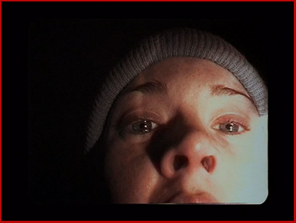
Bottom or Side Lighting – direct lighting from below or the side, which often makes the subject appear dangerous or evil
From the movie The Blair Witch Project

Slide 19
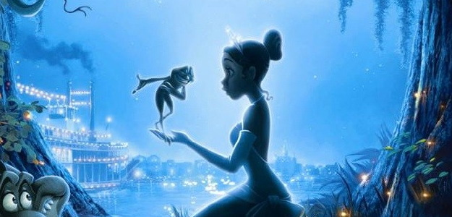
Front or Back Lighting – soft lighting on the actor’s face or from behind which gives the appearance of innocence or goodness, or a halo effect.
From the movie The Princess and the Frog

Slide 20
Editing Techniques
Compares to how a writer uses syntax
Cut – two pieces of film are spliced together to “cut” to another image
Fade – can be to or from black and white; implies the passing of time or the end of a scene
  Fade-In – darkness to brightness
  Fade-Out – image gradually gets darker
Dissolve – a kind of fade in which one image is gradually replaced by another
Wipe – a new image wipes off the previous image (quicker than a dissolve)
Flashback – cut or dissolve to action that happened in the past
Shot-Reverse-Shot – a shot of one subject, then another, than back to the first; often used for conversation or reaction shots
Cross-Cutting – cut into action that is happening simultaneously; creates tension or suspense and creates a connection between scenes
Eye-Line Match – cut to an object, then to a person; can reveal a character’s thoughts

Slide 21
Sound
Compares to how a writer establishes tone and mood in their work
Diegetic – sound that can logically be heard by the characters in the film (dialogue, background noise, sound of things in the scene)
Non-Diegetic – sound that cannot be heard by the characters but is designed for the audience reaction only (ominous music or sounds)

